Slide 1
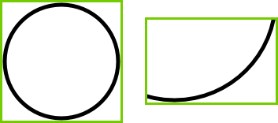


$$A$$
$$\vec{p}$$
m_vTopLeft
m_vBottomRt

Slide 2





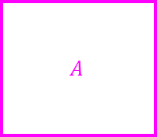



$$\vec{u}=[u_{x},u_{y}]$$
$$\vec{p}=[p_{x},p_{y}]$$
$$\vec{v}=[v_{x},v_{y}]$$
$$[a_{l},a_{t}]$$
$$A$$
$$[b_{l},b_{t}]$$
$$B$$
$$[a_{r},a_{b}]$$
$$[b_{r},b_{b}]$$

Slide 3
CShape
CLine
CLineSeg
CKinematicLineSeg

Slide 4
CShape
CPoint
CKinematicPoint

Slide 5
CShape
CCircle
CArc
CKinematicCircle
CKinematicArc
CDynamicCircle

Slide 6
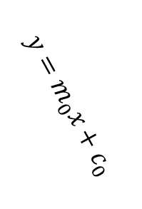

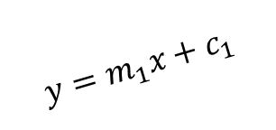
Line Intersect Line Case 1: This Line Not Vertical
$$y=m_{0}x+c_{0}$$
$$y=m_{1}x+c_{1}$$
$$\vec{p}=[p_{x},p_{y}]$$

Slide 7


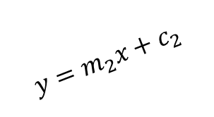
Line Intersect Line Case 2: This Line Vertical
$$x=c_{1}$$
$$\vec{p}=[p_{x},p_{y}]$$
$$y=m_{2}x+c_{2}$$

Slide 8

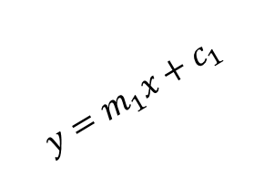

Closest Point on Line
$$y=\frac{−1}{m_{1}}x+c_{1}$$
$$y=m_{1}x+c_{1}$$
$$\vec{p}$$

